Slide 1






RIYA MITTAL AND YASH SINGHVI’S
ARTIFICIAL INTELLIGENCE PROJECT

Slide 2

Predicting Cancellations Of Hotel Reservations Using AI
In this hotel reservations project, we will develop a machine learning model that can forecast whether or not a certain reservation made by a user will be canceled.
In this project, we will commence with collecting and segregating pertinent datasets. Followed by basic and advanced data analysis, furthermore, applying the concepts of machine learning to build a functional and optimized machine learning model.
Some of the domains and platforms where this project can be applied are online traveling and reservation platforms such as MakeMyTrip, GoIbibo, EaseMyTrip, Airbnb, Oyo, Booking.com, Yatra, Expedia, Agoda, etc. All such platforms shall benefit from this model to predict and project the cancellation of reservations that have been made by the customers.
All of these platforms may anticipate an increase in income by reducing the probability of hotel cancellation with the use of this data science and machine learning initiative.

Slide 3

Agenda
Problem Statement & Objectives
Data Description
Exploratory Data Analysis
Model Evaluation
Best Model & Important Variables
References

Slide 4




Problem Statement
High Distribution Cost
Unpredictable Occupancy Rate
Irregular Cash Flow
Impacts

Slide 5




Project objectives
DESCRIPTIVE ANALYSIS
CUSTOMER SEGMENTATION & SEASONALITY
MODEL BUILDING
ACTIONALBE INSIGHTS

Slide 6

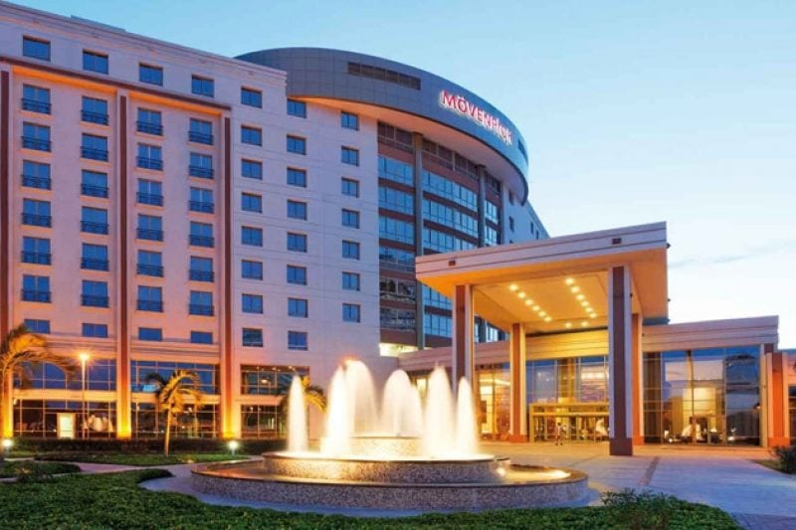
Data Description
Data for 119390 bookings.
25 variables (11 categorical and 14 numerical)
Target variable ‘is_canceled’
Time Period of the dataset used :
2015-2017
This Photo by Unknown Author is licensed under CC BY-NC-ND

Slide 7
Steps of Implementation
Importing the data from the dataset (hotel_bookings.csv)
-The following data set was imported from Kaggle.
2. Cleaning the data
-We checked for null valued features.
-Features that contained fewer null entries were imputed by replacing it with mode (i.e. COUNTRY).
-Features that contained a lot of null entries were completely dropped from the data set (i.e. AGENT and COMPANY).
-The records in the dataset that consisted of booking for 0 adults and 0 children, and 0 babies were dropped. (INVALID ENTRIES)
3. Classifying the nationalities of the guests
-We calculated the mode of the guests that did not cancel their reservations with respect to their country and replaced the country with a numeric value.
-This was further analysed with the total cumulative value of guests that turned up for their reservations.
4. Calculating how much guests pay for a room per night
-Bookings which weren’t canceled, were examined based on the hotel type. (i.e. RESORT and CITY HOTEL)
-Followed by distribution based on room types and their Average Daily Rate.

Slide 8
Steps of Implementation
5. Calculation of the busiest months in a year
-We calculated the total rush in both the types of hotels by the number of guests that turned up each month.
-This gave us the season for maximum bookings of the hotel and maximum footfall.
6. Calculation of the highest average daily rate classified by months
-We compared the Average Daily Rate of bookings that were cancelled and not cancelled.
7. Analysis of whether bookings were made only for weekdays or for weekends or for both
-The data was then further classified into bookings that were made only for weekdays, only weekends and both.
-Some data that did not fit into these 3 categories were marked as UNDEFINED (entries that had more than 5 weekday bookings but 0 weekend bookings, etc.)
-Data was sorted with respect to count and grouped by month.
8. Creating some more features
Four new features were added:
-Family: Booking that were made with at least one adult and at least one child or baby was defined as a family. This way three features were reduced to one, which helped refined the data set.
-Total customers: Sum of adults, children and babies were put into this feature.
-Total nights: The data from the reservations for weekdays and weekends were summed into this feature.
-Deposit type: No Deposit, Non Refund, Refundable were mapped to 0, 1 and 0 respectively to help analyse the data better.

Slide 9
Steps of Implementation
9. Feature encoding of data
-We converted all different categorical data types to numeric values.
-This was achieved by using mean encoding. Mean encoding represents a probability of your target variable, conditional on each value of the feature.
10. Handling the outliers in the dataset
-Generally, normal and gaussian distribution is best suited for an ML model.
-To do so, we must handle the outliers which disrupt the distribution of the data.
-To handle the negative entries in some records, we used log(x+1) instead of log(x).
-We further dropped all records that had null values after applying logarithmic function.
11. Selecting important features using co-relation & univariate analysis
-If there is a high correlation between two features, it is OVERFITTING and is not suitable for data analysis.
-If there is a low correlation between two features, it is UNDERFITTING and is not suitable for data analysis.
-So, we drop all features that had OVERFITTING or UNDERFITTING with is_canceled feature of the data set.
12. Finding important features for model building
-The features were classified as DEPENDENT and INDEPENDENT using alpha values in lasso learning model.
-The bigger the alpha value the fewer features that will be selected.

Slide 10
Steps of Implementation
13. Building a machine learning model by splitting the dataset into training and testing data
-We separated the entire data set into training and testing models.
-We used 75% of the data to train and 25% to test the model accuracy.
14. Cross-validating the model
-Cross-validation is a statistical technique for assessing and contrasting learning algorithms that involves splitting the data into two sections: one for learning or training a model and the other for model validation.
-We applied a 10-fold cross-validation model.
15. Applying multiple algorithms.
-We applied several algorithms and calculated their accuracy percentage along with the confusion matrix.
Algorithms applied:
Logistic Regression
Naïve Bayes
K Nearest Neighbours (KNN)
Decision Tree
Random Forest
16. Manually checking our model.
-Random entries from the dataset were chosen to test the model and cross-checked with the is_canceled feature.

Slide 11

Exploratory Data Analysis
Booking
Transactions
Customer Profiles
Nationalities
Market Segments
Distribution Channels
Meals
Booking Change Log
Database Tables

Slide 12
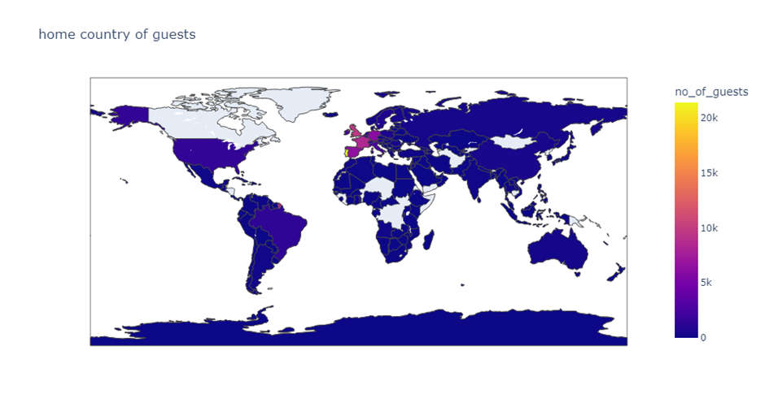
Exploratory Data Analysis
Nationalities of the guests:
People from all over the world are staying in these two hotels. Most guests are from Portugal and other countries in Europe.
Persona 2
Persona 3
Visualize the ideal customer for which your solutions are intended.
Visualize the ideal customer for which your solutions are intended.

Slide 13
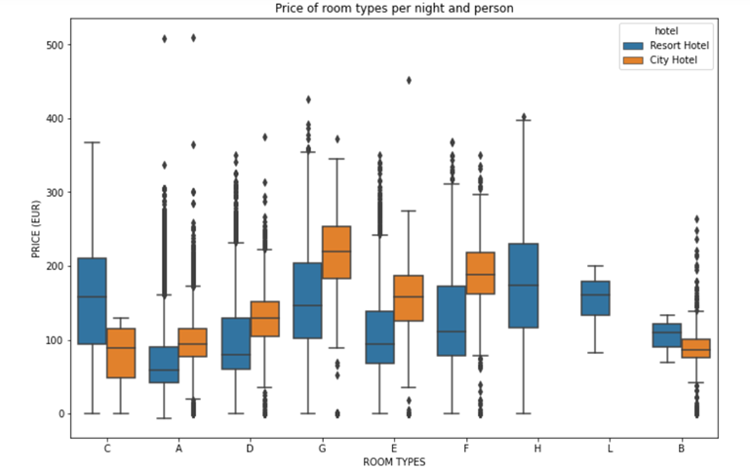
Exploratory Data Analysis
Prices of room types per night and person:
This figure shows the average price per room and the standard deviation, depending on its type. Note that due to data anonymization, rooms with the same type of letter may not necessarily be the same across hotels.
Persona 2
Persona 3
Visualize the ideal customer for which your solutions are intended.
Visualize the ideal customer for which your solutions are intended.

Slide 14
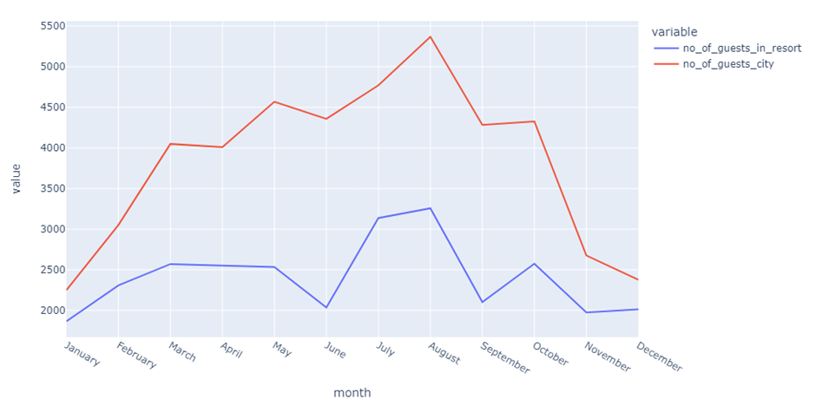
Exploratory Data Analysis
Rush of hotels in various months:
This figure clearly shows that the rush in the Resort hotels are much higher during the summer. The rush in the city hotel varies less and is most expensive during spring and autumn.
Persona 3
Visualize the ideal customer for which your solutions are intended.

Slide 15
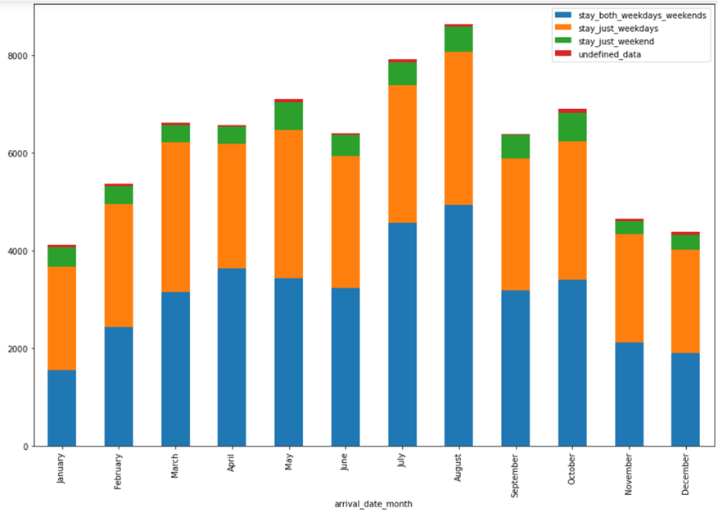
Exploratory Data Analysis
Stay for weekdays and weekends:
Most bookings were made both for weekends and weekdays.
Persona 3
Visualize the ideal customer for which your solutions are intended.

Slide 16
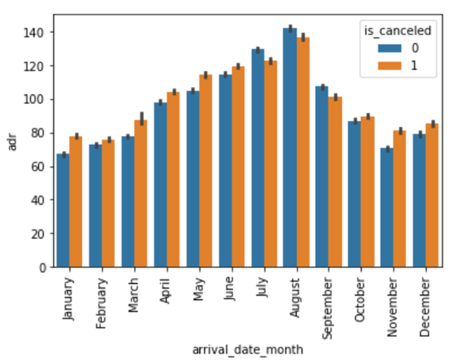
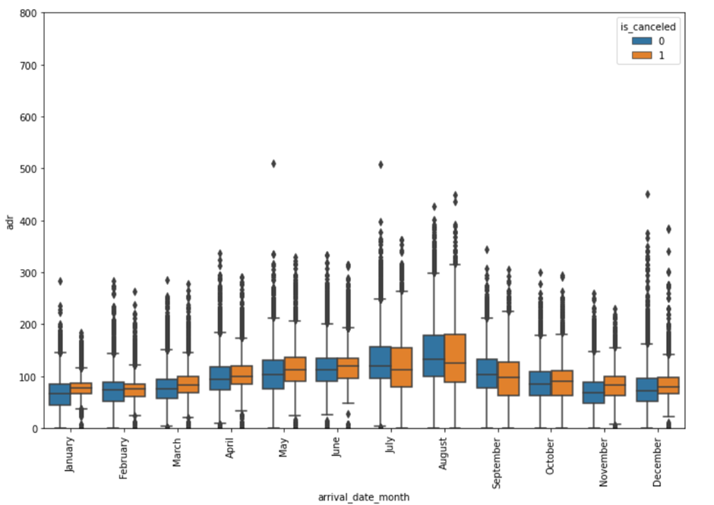
Exploratory Data Analysis

Slide 17

Model Evaluation

Slide 18
Logistic Regression
Confusion Matrix:
[[17464 1312]
[ 4663 6364]]
Accuracy Score:
0.7995168271650505
Classification Report:
precision recall f1-score support
0 0.79 0.93 0.85 18776
1 0.83 0.58 0.68 11027
accuracy 0.80 29803
macro avg 0.81 0.75 0.77 29803
weighted avg 0.80 0.80 0.79 29803
Naïve Bayes
Confusion Matrix:
[[ 6674 12102]
[ 662 10365]]
Accuracy Score:
0.5717209676878167
Classification Report:
precision recall f1-score support
0 0.91 0.36 0.51 18776
1 0.46 0.94 0.62 11027
accuracy 0.57 29803
macro avg 0.69 0.65 0.57 29803
weighted avg 0.74 0.57 0.55 29803

Slide 19
Random Forest
Confusion Matrix:
[[17230 1546]
[ 2780 8247]]
Accuracy Score:
0.8548468275005872
Classification Report:
precision recall f1-score support
0 0.86 0.92 0.89 18776
1 0.84 0.75 0.79 11027
accuracy 0.85 29803
macro avg 0.85 0.83 0.84 29803
weighted avg 0.85 0.85 0.85 29803
Decision Tree
Confusion Matrix:
[[15976 2800]
[ 2675 8352]]
Accuracy Score:
0.8162936617119082
Classification Report:
precision recall f1-score support
0 0.86 0.85 0.85 18776
1 0.75 0.76 0.75 11027
accuracy 0.82 29803
macro avg 0.80 0.80 0.80 29803
weighted avg 0.82 0.82 0.82 29803

Slide 20
KNN
Confusion Matrix:
[[16847 1929]
[ 3409 7618]]
Accuracy Score:
0.8208905143777472
Classification Report:
precision recall f1-score support
0 0.83 0.90 0.86 18776
1 0.80 0.69 0.74 11027
accuracy 0.82 29803
macro avg 0.81 0.79 0.80 29803
weighted avg 0.82 0.82 0.82 29803

Slide 21
Best Model & Important Variables
We can conclude with our study, that given 12 features such as 'country', 'lead_time', 'previous_cancellations', 'previous_bookings_not_canceled', 'booking_changes', 'days_in_waiting_list', 'adr’, 'required_car_parking_spaces', 'total_of_special_requests', 'total_customer', 'total_nights', 'deposit_given', we can predict the cancellation of hotel reservations accurately 85% of the times using Random Forest Algorithm.

Slide 22



References
[1] N. Antonio, A. Almeida, L. Nunes, Predicting hotel bookings cancellation with a machine learning classification model, in:
Proceedings of the 16th IEEE International Conference Machine Learning Application, IEEE, Cancun, Mexicopp. 1049–1054.
doi: 10.1109/ICMLA.2017.00-11, 2017.
[2] International Civil Aviation Organization, Guidelines on Passenger Name Record (PNR) data, (2010). 〈 https://www.iata.org/iata/passenger-data-toolkit/assets/doc_library/04-pnr/New%20Doc%209944%201st%20Edition%20PNR.pdf 〉 (accessed 17 February 2016).
[3] D. Abbott, Applied Predictive Analytics: Principles and Techniques for the Professional Data Analyst, Wiley, Indianapolis, IN, USA, 2014.
[4] Microsoft, SQL Server Management Studio (SSMS), (2017).
〈 https://docs.microsoft.com/en-us/sql/ssms/sql-server-management-studio-ssms 〉 (accessed 24 March 2018).
[5] American Hotel & Lodging Association, Uniform System of Accounts for the Lodging Industry, 11th Revised edition.
Educational Institute, New York, 2014.
[6] International Standards Organization, ISO country codes 3166-3:2013,
〈 https://www.iso.org/obp/ui/#iso:std:iso:3166:-3:ed-2:v1:en,fr 〉 (accessed 24 March 2018), 2013.

Slide 23

Thank you!
RIYA MITTAL (106120098)
YASH SINGHVI (106120148)

